Slide 1
Book Recommender
By Shaun Lin

Slide 2
Data science Capstone project
To build a system that can automatically recommend books to users based on the preferences of other readers
Datasets: 10,000 books, rated by 53,000 readers, with tags
I will be using something call collaborative filtering

Slide 3


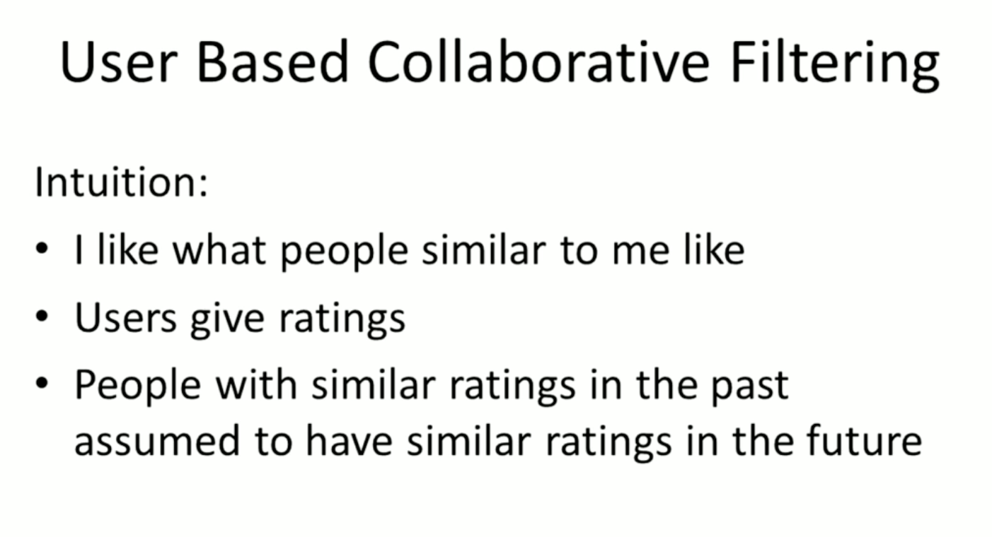
What is Collaborative Filtering ?
Collaborative filtering is a technique that can filter out items that a user might like on the basis of reactions by similar users.

Slide 4
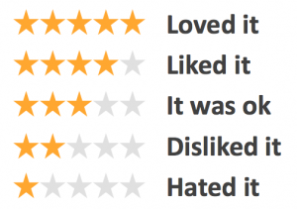
Step 1: Identify the user’s preferences
A list of books that the person has read and rated them from a scale of 1-5
The genre of the books the person prefer

Slide 5
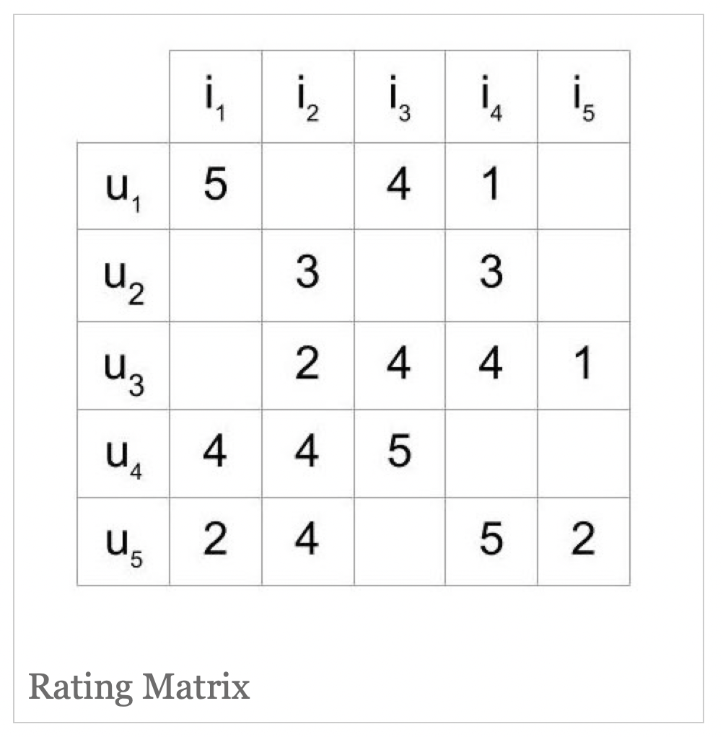
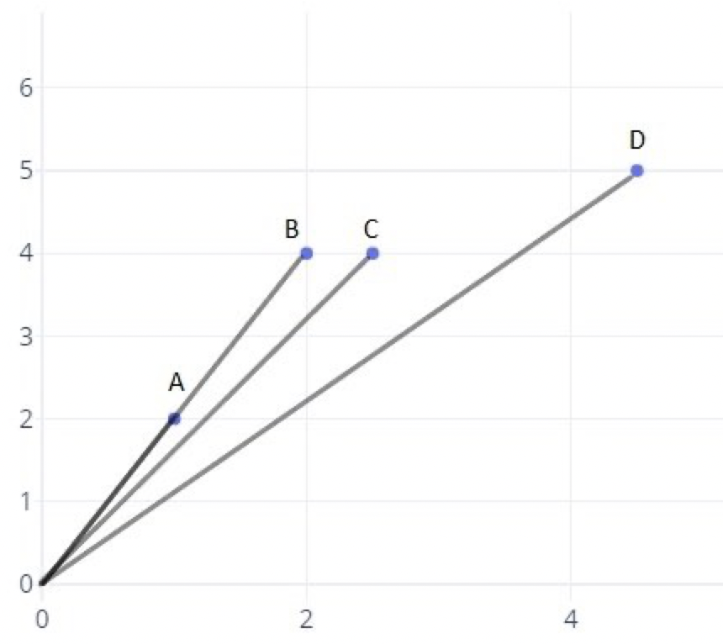
Step 2: Create a matrix, identify which readers are similar to the user
A matrix with five users and
five items could look like this
If the angle between the lines is increased, then the similarity decreases, and if the angle is zero, then the users are very similar.

Slide 6
Step 3: Calculate the book ratings weighted mean average
For each of the 10,000 books against the weighted mean average of 53,000 readers
If the reader has not rated the book, it is excluded from the mean
We’ll give higher weighting for readers who are more similar to the user and lower weighting for readers who are less similar to the user

Slide 7
Step 4: Identify the books to recommend
Not including the books the user already read
We will sort the remaining books by their weighted mean average, the highest one with be at the top

Slide 8
Step 5: Calculating the accuracy of the recommendation system
Accuracy = number of correct recommendations / number of reader’s highly rated books
For ex: an reader has rated 10 books total for a rating of 5 and the engine is able to predict 2 of them, so the accuracy is 2 / 10

Slide 9
Questions ?

